Slide 1

Reference Genome Assembly of Marmota marmota Reveals Molecular Bases of Hibernation and Life at High Altitude
Sofia Natale
MSc in Bioinformatics
University of Bologna
A.Y 2024/2025
Applied Genomics Project

Slide 2
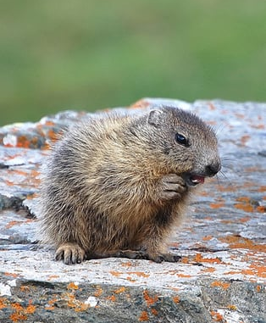

Why the Alpine Marmot?
Scientific gap: no chromosome-scale, high-quality reference genome currently available.
Model species for extreme adaptations
Hibernation (metabolic suppression) and survival under chronic hypoxia.
Distributed along a wide altitudinal gradient (900–2,800 m) in the Alps, facing contrasting selective pressures.
Ecological
relevance
Opportunity
Study molecular bases of energy balance, stress resistance, and environmental adaptation.

Slide 3
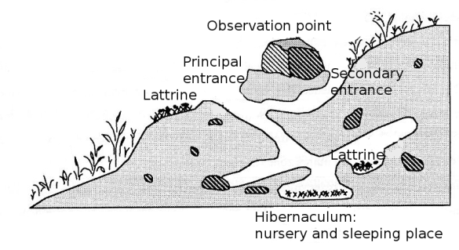
Ecology and Life Cycle
Alpine habitat: colonies distributed from ~1,500 to 3,000 m a.s.l.
Seasonal duality:
Social structure:
Winter → hibernation
(up to 6–7 months underground).
Summer →
active phase (foraging, reproduction).
Cooperative groups
Burrow systems shared across generations.
Physiological shifts
strong metabolic reprogramming between active and hibernating states

Slide 4

Aims of the project
Assemble a chromosome-scale reference genome of the Alpine marmot (Marmota marmota).
Characterize molecular adaptations to extreme environments
Hibernation
(metabolic suppression, thermogenesis)
High-altitude hypoxia
(oxygen transport, energy balance)
Integrate multi-omics approaches (RNA-seq, ATAC-seq, ChIP-seq, WGBS) to link genome to function.
Population genomics: identify loci under selection across altitudinal gradients.
Fill a knowledge gap: no high-quality reference genome currently available for this species.

Slide 5
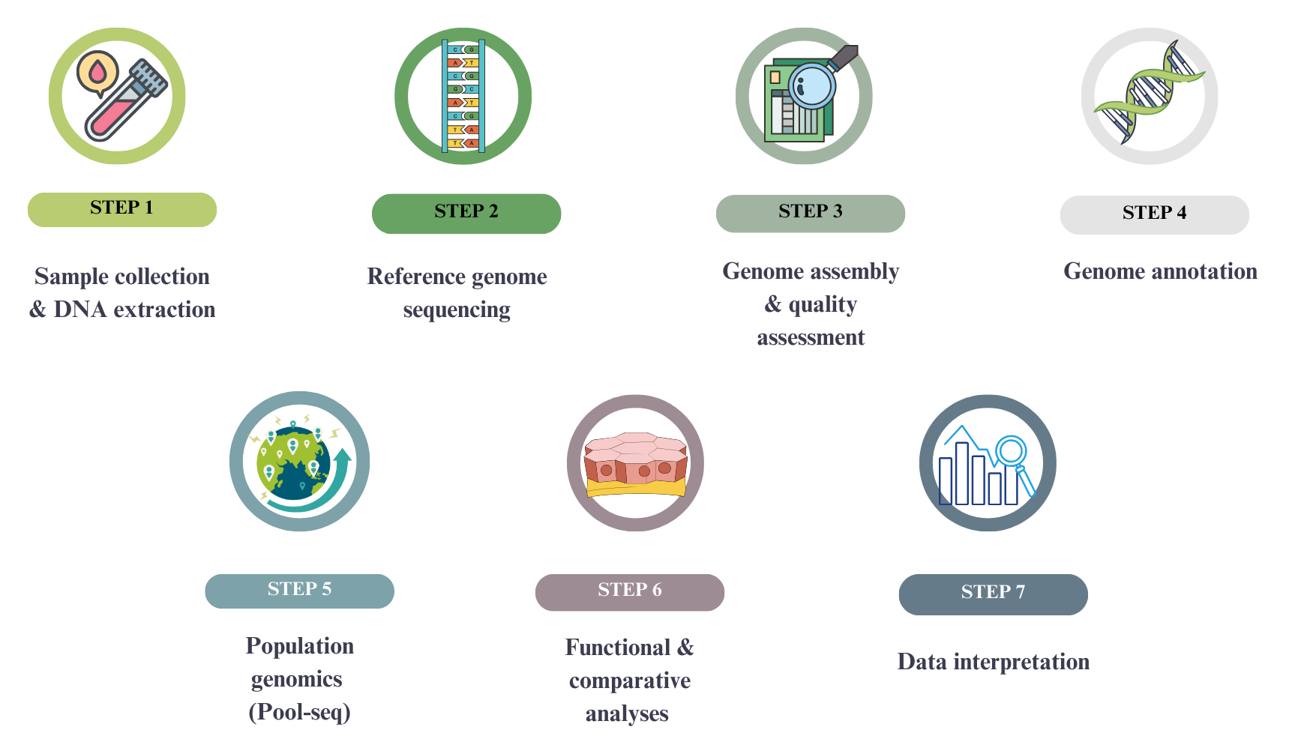
Workflow overview

Slide 6
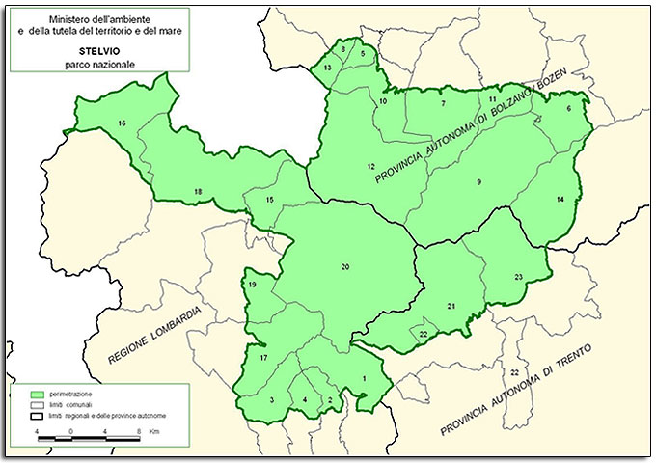
Sample collection
Seasonal campaigns:
Summer (active phase) | Winter (hibernation)
Individuals trapped while foraging | Sampling inside burrows (veterinary supervision)
Collected material
Biopsies: liver, brown adipose tissue, heart, hypothalamus.
Whole blood for HMW DNA extraction
Numbers
~25–30 individuals for reference genome & multi-omics
~800 individuals (80 pools) for population genomics
Study area: Stelvio National Park (Italian Alps)
Ethics → Permits from Stelvio Park Authority & IACUC approval

Slide 7
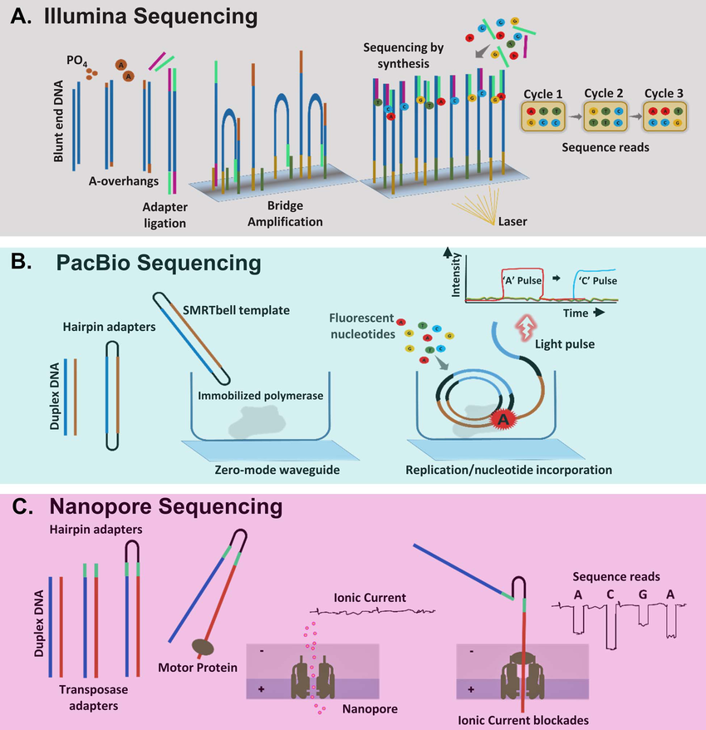
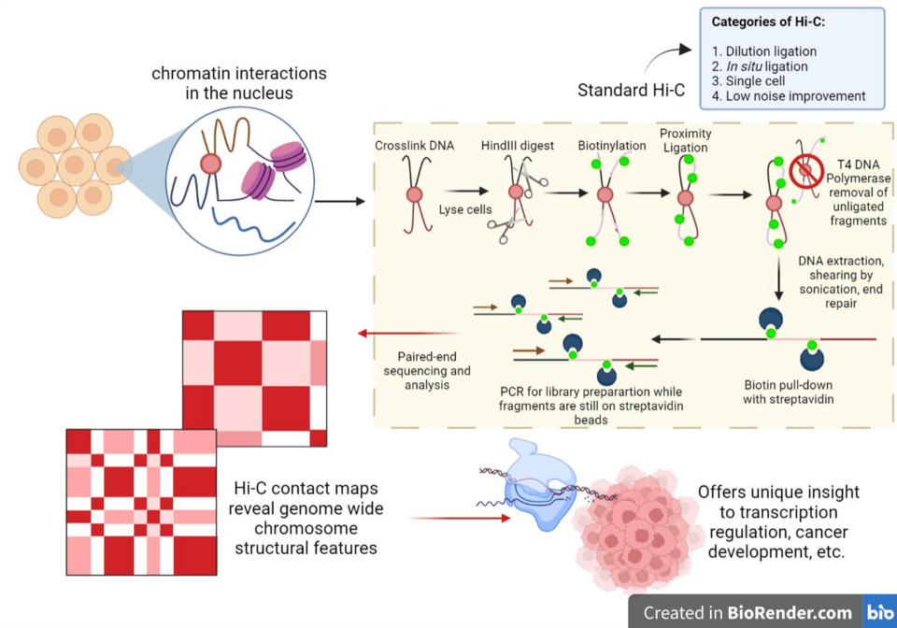
Reference Genome Assembly
High molecular weight DNA from one individual
Hybrid sequencing strategy: de novo → polishing → scaffolding
Hi-C maps
PacBio HiFi
long reads
(>30×, 15–20 kb)
Illumina NovaSeq
short reads
(~30×, polishing)
Chromosome scaffolding, N50 > 50 Mb
Quality: BUSCO >95%, Illumina mapping >95%
Annotation: ab initio + comparative

Slide 8
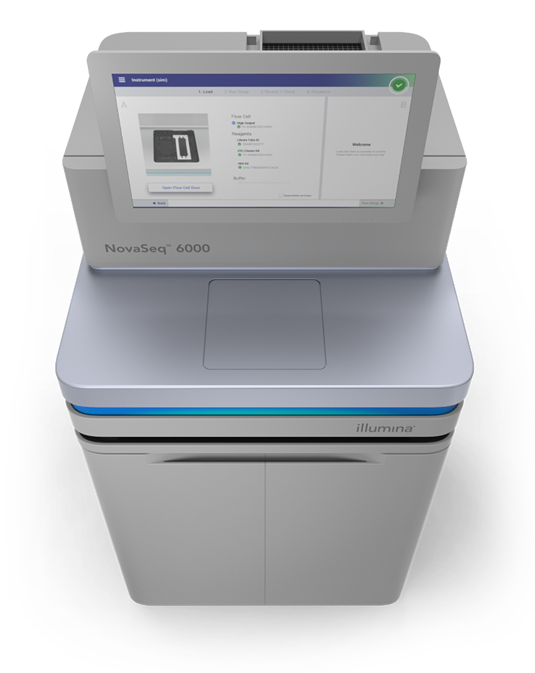
Population Genomics (Pool-seq)
Pool-seq strategy → allele frequency estimation
Design | Sequencing | Variant discovery | SNP/indel calling
10 populations along altitudinal gradient | Illumina NovaSeq 6000, 150 bp PE reads | Alignment with BWA-MEM | GATK HaplotypeCaller (pooled mode)
~800 individuals grouped into 80 pools (10 per population × 4 technical replicates
Coverage: 50–80× per pool
QC: FastQC, MultiQC, fastp
Filtering and allele frequency estimation with BCFtools
Goal → identify candidate loci under selection linked to altitude & hibernation
Analyses
Genetic diversity: π, Watterson’s θ
Population differentiation: pairwise F_ST (lowland vs. highland)
Neutrality tests: Tajima’s D

Slide 9
Functional analyses
RNA-seq (transcriptome profiling)
ATAC-seq & H3K27ac ChIP-seq (chromatin accessibility & enhancers)
Tissues: liver, brown adipose tissue, heart, hypothalamus
States: active (summer) vs hibernating (winter)
Detect transcriptional reprogramming during hibernation (metabolism, thermogenesis, circannual rhythm
Tissues: liver, BAT, hypothalamus
Identify active regulatory elements and enhancer dynamics controlling seasonal transitions
Multi-Omics approaches
Orthology with related rodents
Distinguish conserved vs lineage-specific adaptations to hibernation and altitude
Highlight candidate genes and regulatory networks underlying adaptation to hypoxia and prolonged hibernation
WGBS (DNA methylation maps)
Tissues: liver, hypothalamus
Reveal epigenetic regulation of key metabolic and hypoxia-related genes
Comparative genomics

Slide 10
Cost estimation
Category | Details | Estimated cost (€)
Sample collection & DNA | Fieldwork & logistics (40,000 €), Laboratory consumables (20,000 €), Shipping & cold chain (8,000 €) Permits & ethics (5,000 €) | 73,000
Reference genome | Reference genome (Illumina + PacBio HiFi + Hi-C) (27,400 €), Hi-C extra (2700 €) | 30,100
Genome assembly & quality assesment | HPC & storage | 15,000
Population genomics | Pool-seq | 20,000
Functional assays | RNA-seq (12,400 €), ATAC-seq: (5,000 €), ChIP-seq H3K27ac (8,000 €), WGBS (Methyl-seq) (15,000 €) | 40,400
Personnel & Dissemination | Laboratory technician (37,500 €), Bioinformatics postdoc (70,000 €), Dissemination / Open Access (8,000 €) | 115,500
Total |  | 294,000

Slide 11
Results
Reference Genome
Chromosome-scale assembly (Scaffold N50 > 50 Mb)
BUSCO completeness >95%
~20,000 protein-coding genes annotated + repeats
Population Genomics
Reduced diversity (π, θ) in high-altitude colonies
Elevated F_ST and Tajima’s D in candidate regions
Candidate genes: oxygen sensing, metabolism, hypoxia adaptation
Functional Multi-omics
RNA-seq → hundreds of DEGs (mitochondrial metabolism, thermogenesis, circannual rhythms)
ATAC-seq / ChIP-seq → thousands of enhancers, TF motifs (HIF, PPAR, circadian regulators)
WGBS → hundreds of DMRs overlapping promoters/enhancers
Comparative → lineage-specific gene family expansions (energy storage, hypoxia signaling)
Overall outcome
Integrated evidence for molecular mechanisms enabling hibernation & high-altitude survival

Slide 12
Conclusion
Perspectives: insights into hypoxia tolerance and metabolic suppression relevant to biomedicine, plus genomic tools for conservation under climate change.
Dual sampling (season + altitude)
Strengths
Hybrid assembly
Multi-omics integration provide a solid framework to study adaptation
Unresolved repeats
Need for experimental validation
More information & resources
Full GitHub repository: https://github.com/sofianatale/Applied_Genomics
Final Report (PDF): REPORT_AG_NATALE_SOFIA.pdf
Limitations
Demographic confounders
Restricted geographic scope

Slide 13
References
Gossmann, T. I., & Ralser, M. (2020). Marmota marmota. Trends in genetics : TIG, 36(5), 383–384. https://doi.org/10.1016/j.tig.2020.01.006
Ortmann, S., & Heldmaier, G. (2000). Regulation of body temperature and energy requirements of hibernating alpine marmots (Marmota marmota). American journal of physiology. Regulatory, integrative and comparative physiology, 278(3), R698–R704. https://doi.org/10.1152/ajpregu.2000.278.3.R698
Theodoridis, S., et al. (2020). Evolutionary history and past climate change shape genetic diversity in mammals. Nature Communications, 11, 2557. https://doi.org/10.1038/s41467-020-16449-5
Rhoads, A., & Au, K. F. (2015). PacBio sequencing and its applications. Genomics, Proteomics & Bioinformatics, 13(5), 278–289. https://doi.org/10.1016/j.gpb.2015.08.002
Modi, A., Vai, S., Caramelli, D., & Lari, M. (2021). The Illumina sequencing protocol and the NovaSeq 6000 system. Methods Mol Biol, 2242, 15–42. https://doi.org/10.1007/978-1-0716-1099-2_2
Seppey, M., Manni, M., & Zdobnov, E. M. (2019). BUSCO: assessing genome assembly and annotation completeness. Methods Mol Biol, 1962, 227–245. https://doi.org/10.1007/978-1-4939-9173-0_14

